Slide 1
Designing and Developing Power Apps Portals
Notes:
This module introduces students to the Microsoft Power platform and explains the role of canvas apps, connectors and flows in building business solutions. The module introduces the Common Data Service for Apps (CDSA) and explains how it provides support for creating custom entities and building model-driven apps. Students will create canvas apps with Power Apps Studio and learn to write advanced expressions for screen and control properties. The module examines connectors and data binding and demonstrates using the Start with Data template. Along the way students will learn to build a canvas app for mobile devices that reads and writes customer data to a table inside an Excel workbook in OneDrive for Business.

Slide 2
Agenda
Creating a Power Apps Portal
Adding and Editing Portal Content
Writing Liquid Template Language Expressions
Understanding Portal Configuration
Configuring Portal Security
Publishing Dynamic CDS Content

Slide 3
Power Apps Portals
Power Apps portals provide web development platform
Create websites for anonymous users and/or authenticated user
Allows for registration and authentication of internal users
Allows for authentication through LinkedIn, Facebook, Twitter, etc.
Portal content managed by business users
Portal Editor used to add pages and author content
Portal Management app created along with portal
Portal can be customized by web developers
Liquid template language used to add dynamic content
Developers can surface data from CDS entities
Developers can extend portal with custom page templates

Slide 4
Power Apps Portal Architecture
Power Apps portals built on Common Data Service
You must create a environment with CDS database to create portal
CDS used to track data for pages, templates and site content
Creating portals triggers installation of several ADX solutions
Power Apps Environment
Power Apps Environment
Portal 1
Portal 2
CDS Database
CDS Database

Slide 5
Portal Templates
Customer self-service portal
Provides customers with access info, support resources and order status
Partner portal
Provides portal for with resellers, distributors, suppliers and/or partners
Employee self-service portal
streamline common tasks and allows for sharing resource
Community portal
Facilitates interactions between customers and experts
Portal from blank
Minimum portal with a small set of sample pages
The ONLY template available unless you have a Dynamics 365 license

Slide 6
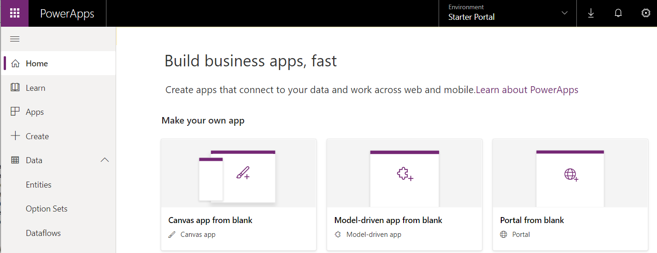
Creating a New Power Apps Portal
New portal created using Power Apps Maker Portal
Select your target environment
Create portal using Portal from blank template

Slide 7
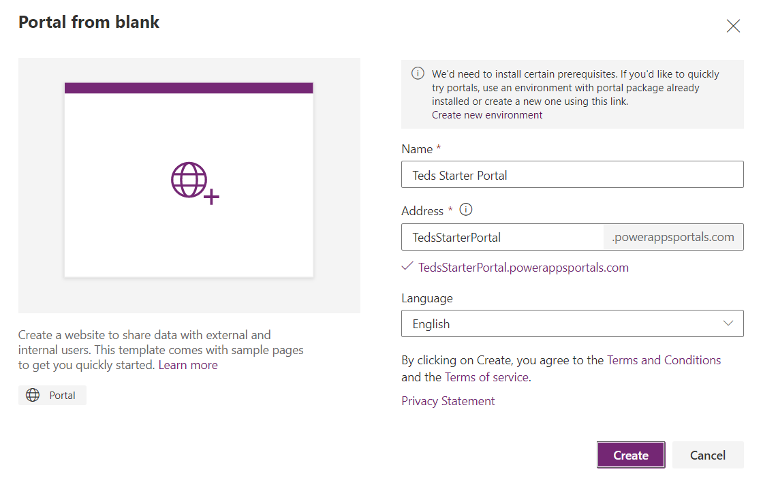
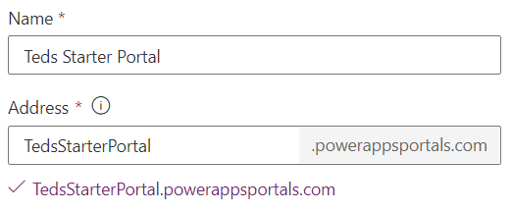
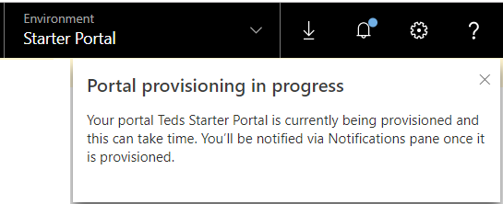
Providing Portal Provisioning Data
Portal requires Name and unique address

Slide 8
Creating a New Power Apps Portal

Slide 9
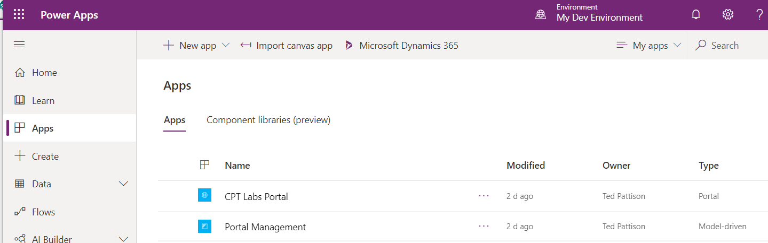
Portal Apps
Provisioning a portal creates two applications
Power Apps portal
Model-driven app named Portal Management

Slide 10
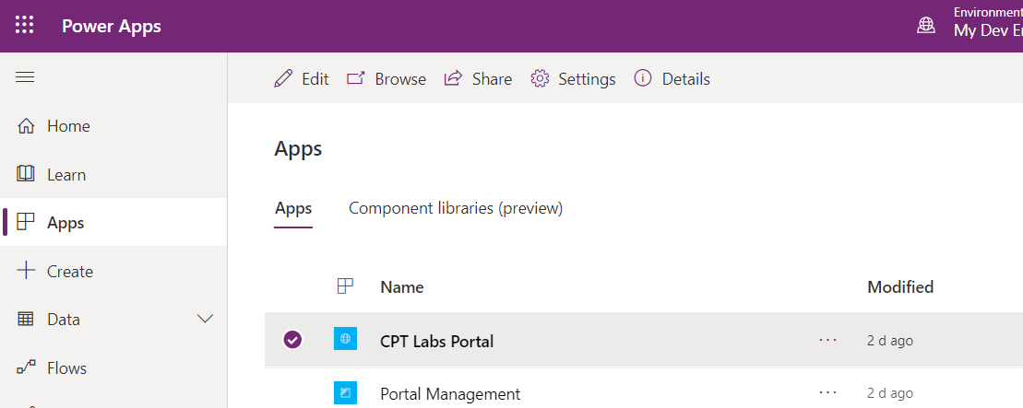
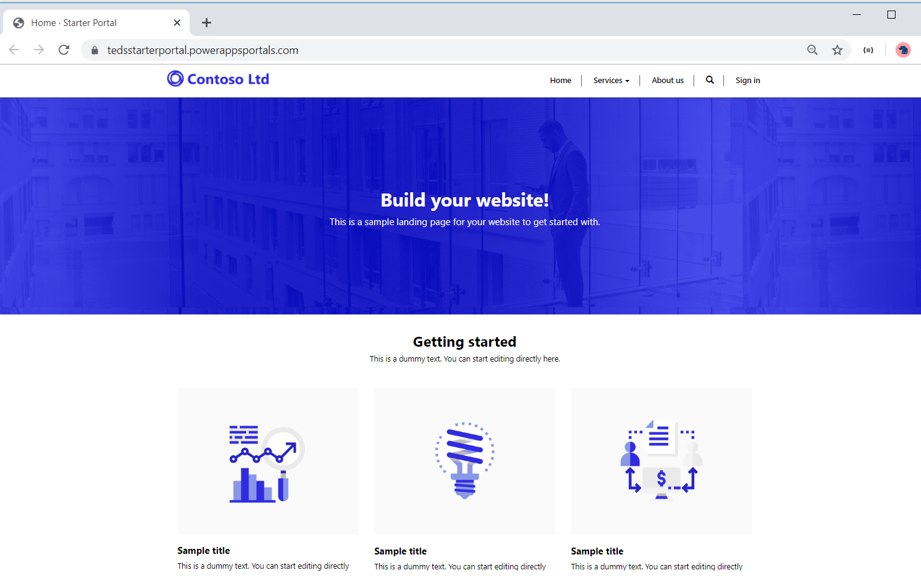
Launching the Portal

Slide 11
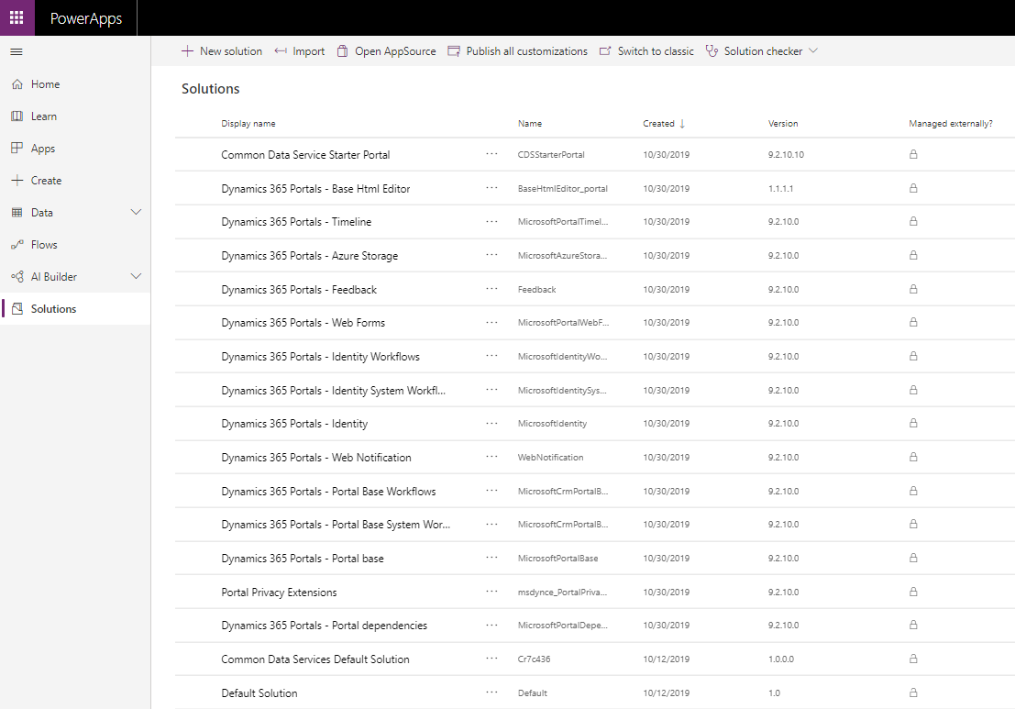
Solutions Installed to Support Portals
Creation of portal triggers installation of ADX solutions

Slide 12
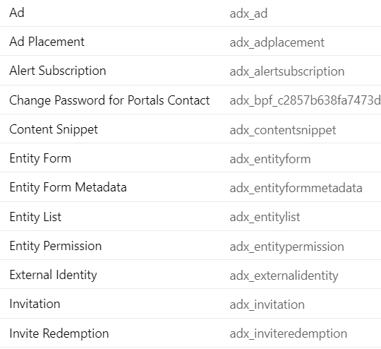
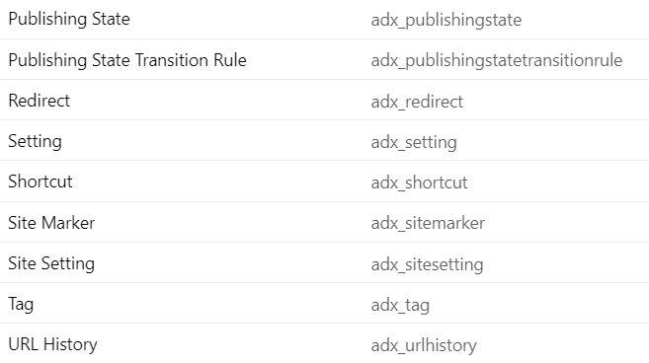
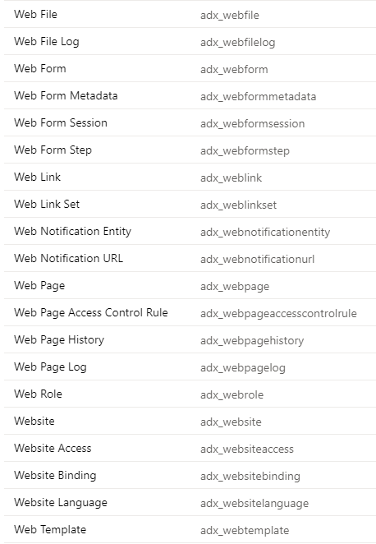
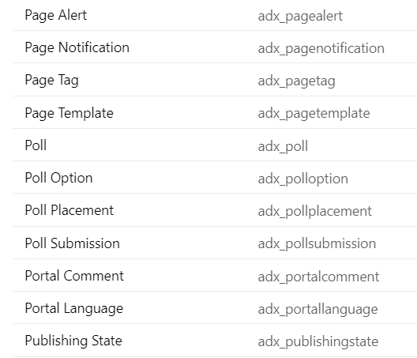
Power Apps Portal Entities

Slide 13
Inspecting a New Power Apps Portal

Slide 14
Agenda
Creating a Power Apps Portal
Adding and Editing Portal Content
Writing Liquid Template Language Expressions
Understanding Portal Configuration
Configuring Portal Security
Publishing Dynamic CDS Content

Slide 15
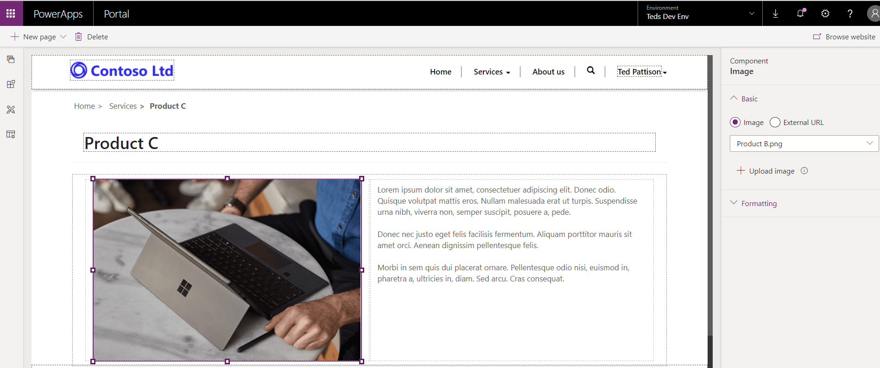
Portal Editor
Used to add pages and author page content
Designed for less-technical users
Editor does not require web designer/developer skills

Slide 16
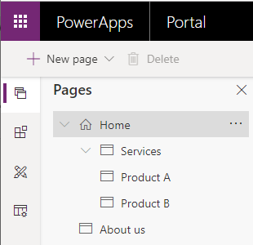
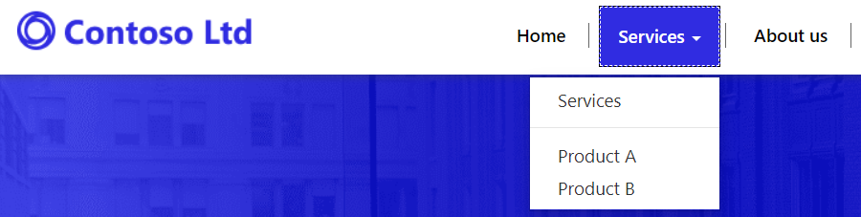
Page Hierarchy
Web Page can have one or more child pages
Provides foundation for building page hierarchy
Page hierarchy used to build navigation menu

Slide 17
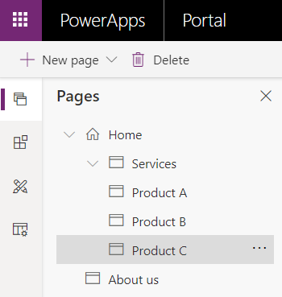
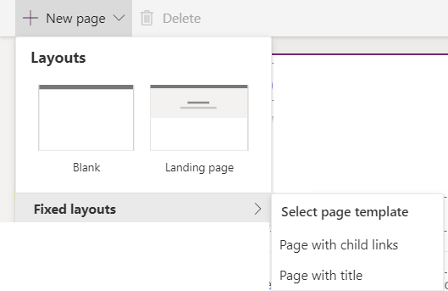
Adding and Navigating Pages
Pages tab provides navigation across pages
Pages added using New page menu button

Slide 18
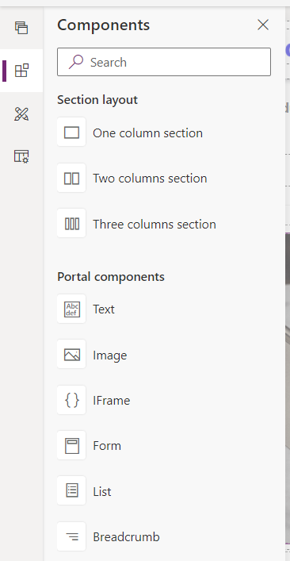
Adding Page Content using Components
Portal Editor provides Components for content authors
You drag components onto the Page Copy placeholder
Sections used to constrain max page width and create responsive design
Page Copy placeholder
Two columns section
Text
Text
Image
Three columns section
Image
Image
Image
Text
Text
Text

Slide 19
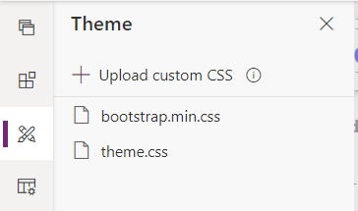
Portal Themes
Portals out-of-box branding based on Bootstrap 3
bootstrap.css version 3.3 automatically included
You can add custom CSS style rules to themes.css
Upgrading to newer version of Bootstrap (e.g. v4) not supported

Slide 20
Adding and Editing Web Content with the Power Apps Portal Editor

Slide 21
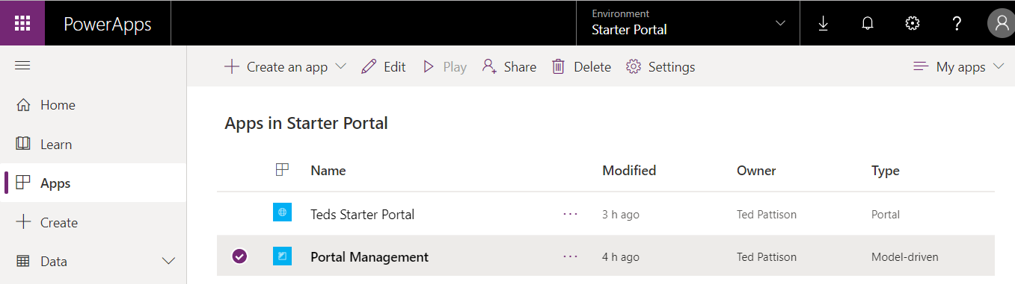
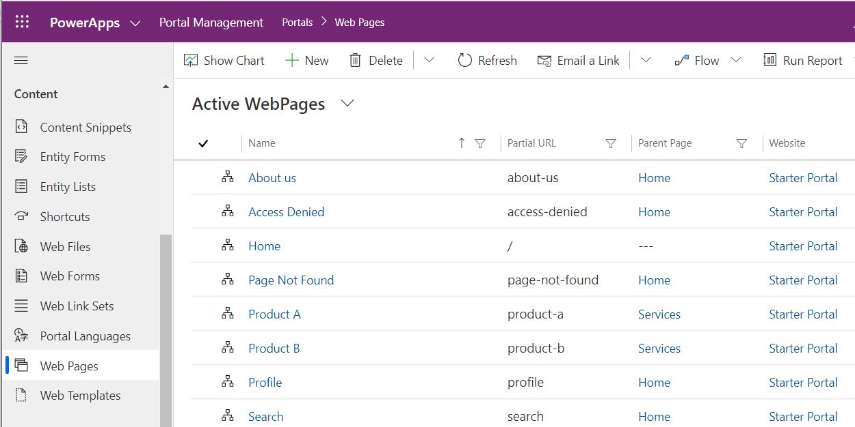
Portal Management App

Slide 22
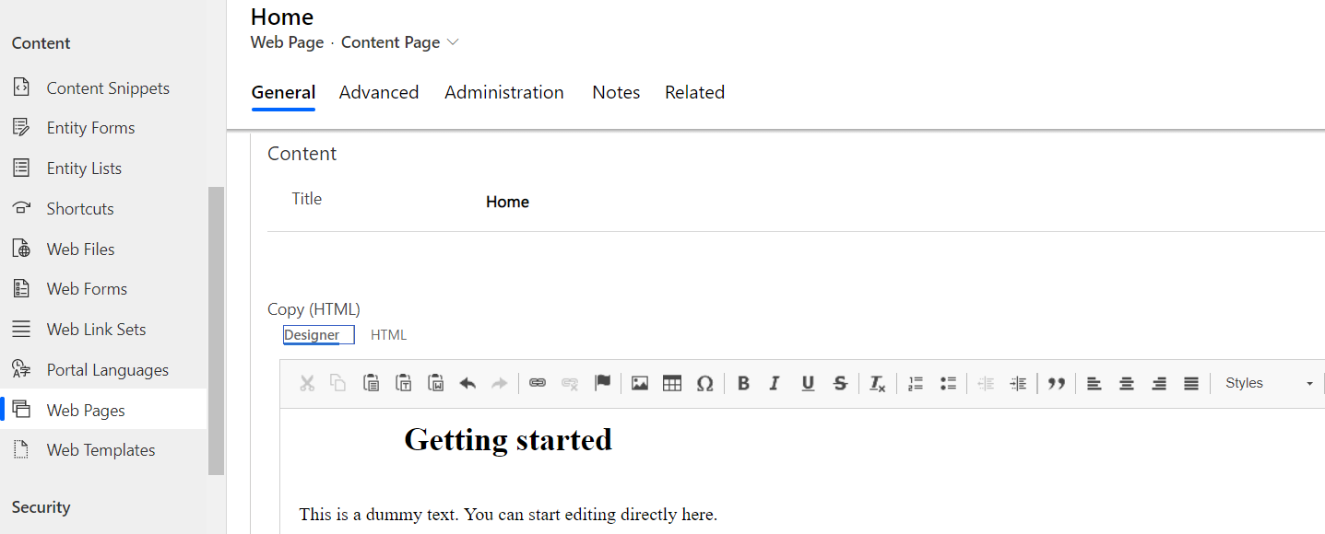
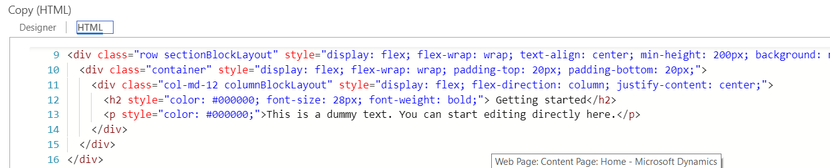
Editing Page Content
Portal Management App provides access to web pages
You can edit web page properties
You can editor page content using the Designer editor
You can editor page content using the Designer editor

Slide 23
Agenda
Creating a Power Apps Portal
Adding and Editing Portal Content
Writing Liquid Template Language Expressions
Understanding Portal Configuration
Configuring Portal Security
Publishing Dynamic CDS Content

Slide 24
Liquid Template Language
Power Apps Portals use Liquid Template Language
Open-source template language created by Shopify in 2006
Currently used by 100s of websites and ISVs
Liquid used on portal pages to generate dynamic content
Liquid markup code stored in CDS along with HTML
Liquid was designed to surface data from databases on web pages
Learning the fundamentals of the Liquid template language
Liquid Objects
Liquid Tags
Liquid Filters

Slide 25
Liquid Objects
The follow Liquid objects are available in Power Apps portals
Power Apps-specific reference for Liquid template language
https://docs.microsoft.com/en-us/Power Apps/maker/portals/liquid/liquid-overview
now | A date/time object that refers to the current UTC time at the time the template is rendered.
page | current portal request page with title and URL
params | request.parameters from query string.
request | Contains information about the current HTTP request.
settings | Allows you to load any Site Setting by name.
sitemap | Allows access to the portal site map.
sitemarkers | Allows you to load any Site Markers by name.
snippets | Allows you to load any Content Snippet by name.
user | Refers to the current portal user. If no user is signed in, this variable will be null.
weblinks | Allows you to load any Web Link Set by name or ID.
website | current portal Website record with website properties.

Slide 26
Liquid Objects
Liquid objects are referenced by name
user
page
request
Object properties referenced using dot notation
user.fullname
page.title
request.params['HTTP_CLIENT_IP']
Object properties displayed using output tags {{ … }}
{{ user.fullname }}
{{ page.title }}
{{ request.params['HTTP_CLIENT_IP'] }}

Slide 27
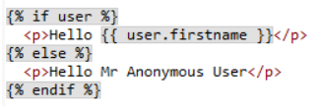


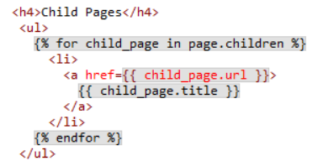
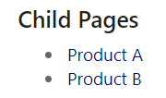
Liquid Tags - {% … %}
Liquid provides tags with control-of-flow logic
if statement tags
for loops tags

Slide 28
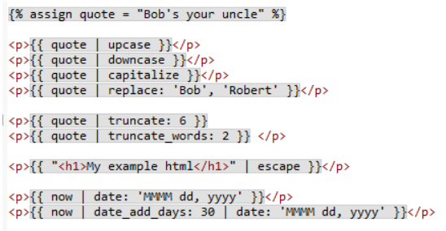
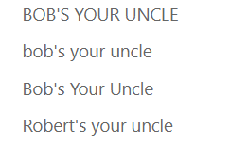



Liquid Filters
Filters used to transform data
Use of filter requires pipe operator | followed by filter name
Filter arguments (if any) passed using colon operator :

Slide 29
Agenda
Creating a Power Apps Portal
Adding and Editing Portal Content
Writing Liquid Template Language Expressions
Understanding Portal Configuration
Configuring Portal Security
Publishing Dynamic CDS Content

Slide 30
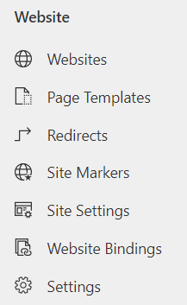
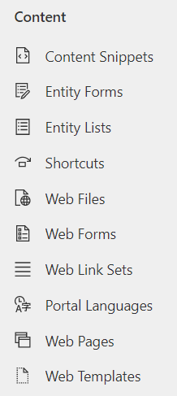
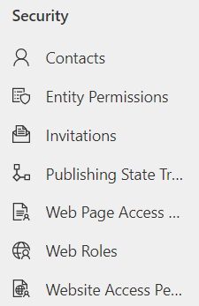
Portal Management App Entities
Portal Management app provides access to portal entities
Website entities
Content entities
Security entities

Slide 31
Web Templates and Page Templates
Every Web Page is based on a Page Template
Several page templates are available out of the box
You can add new page templates
Every Page Template is based on a Web Template
Some Web Templates are designed as full page templates
Some Web Templates are designed as partial page templates
Web Templates can pull content from Content Snippets
Snippets provide easy-to-edit sections in a portal web site

Slide 32
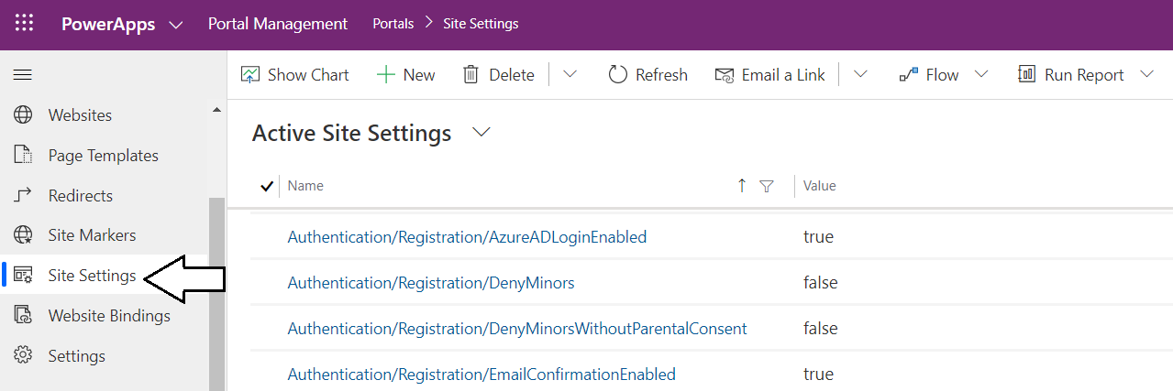
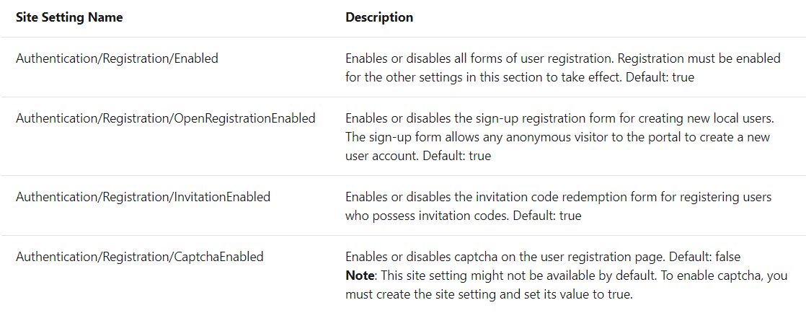
Configuring Portal Registration Features
Portal authentication features configured using Site Settings
Site Setting key documented by Microsoft

Slide 33
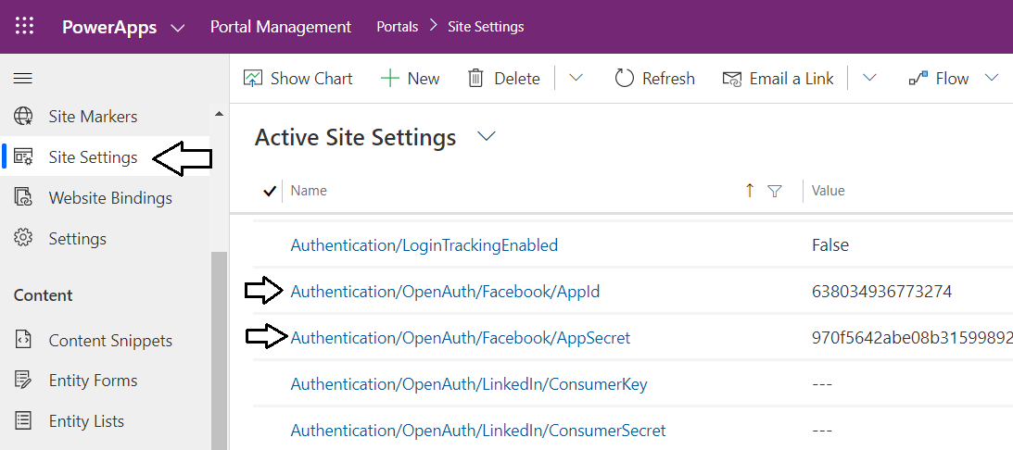
Configuring Third Party Identity Providers
External identity providers configured using Site Settings
Requires pre-creating app with identity provider
App ID and App Secret added as Site settings

Slide 34
Agenda
Creating a Power Apps Portal
Adding and Editing Portal Content
Writing Liquid Template Language Expressions
Understanding Portal Configuration
Configuring Portal Security
Publishing Dynamic CDS Content

Slide 35
Power Apps Portal Audiences
Anonymous users
Users that usually just need to view public content
Authenticated users
Users that need to view secured content
Users that need to add and edit content
Content managers
Users that need to author pages and CDS records
Portal administrators
Users that need to monitor and administrate portal

Slide 36
Power Apps Portal Security Model
Every portal user associated with Contact record
Contact entity provides foundation for user identity
Contact records used to manage permissions and authorization
Configurable Authorization for Portal Access
Page viewing: is the user authorized to view a page
Page authoring: is the user authorized to edit & publish pages?
CDS Entities: is the user allowed to view or edit CDS records?
Website authoring: can the user edit site settings and navigation?

Slide 37
User Authentication in Power Apps Portals
Local authentication
Everything about user identity stored in Contact record
User name and hashed password stored in Contact
No need for external identity providers
External authentication
Authentication provider by external identity provider
Azure AD used to authenticate users from same tenant as portal
Azure AD can be used to authenticate guest users for other tenants
Third party identity providers can be used to authenticate external users

Slide 38
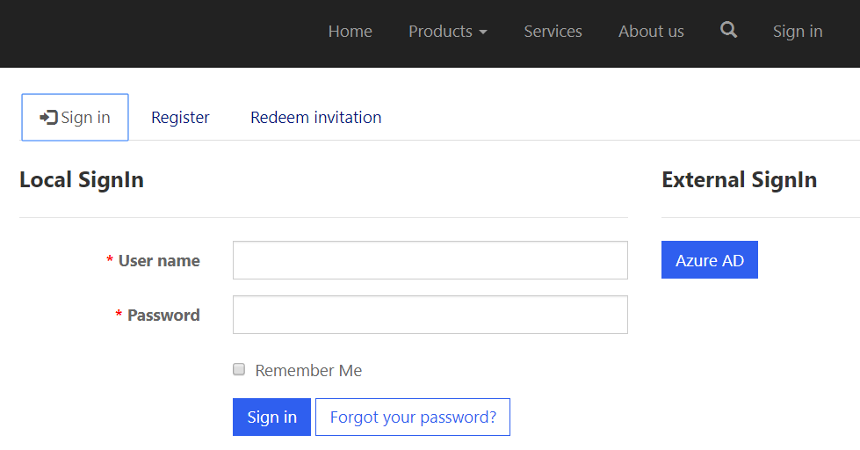
Default Logon Screen
What type of login is supported by default?
Local registration and authentication
Azure AD authentication (auto-registration)

Slide 39
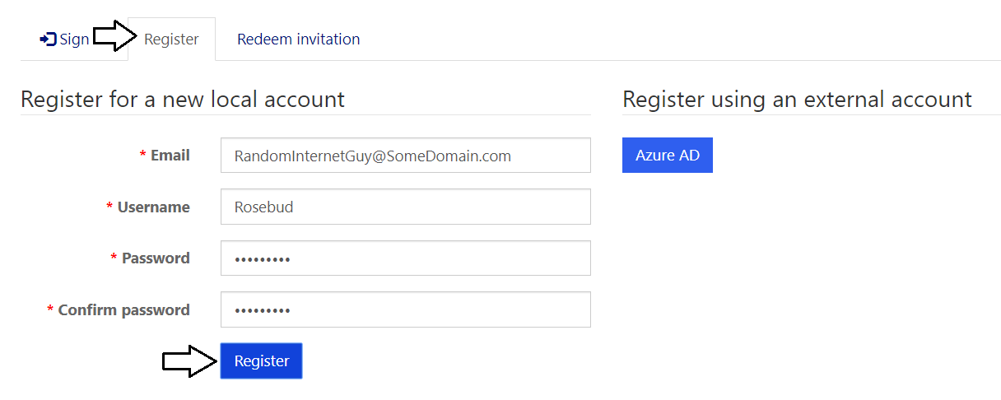
Registering a Local Account
Local authentication requires account registration
Registration results in new Contacts record for user
User password saved in Contacts records as hashed value
Portal requires email confirmation by default

Slide 40
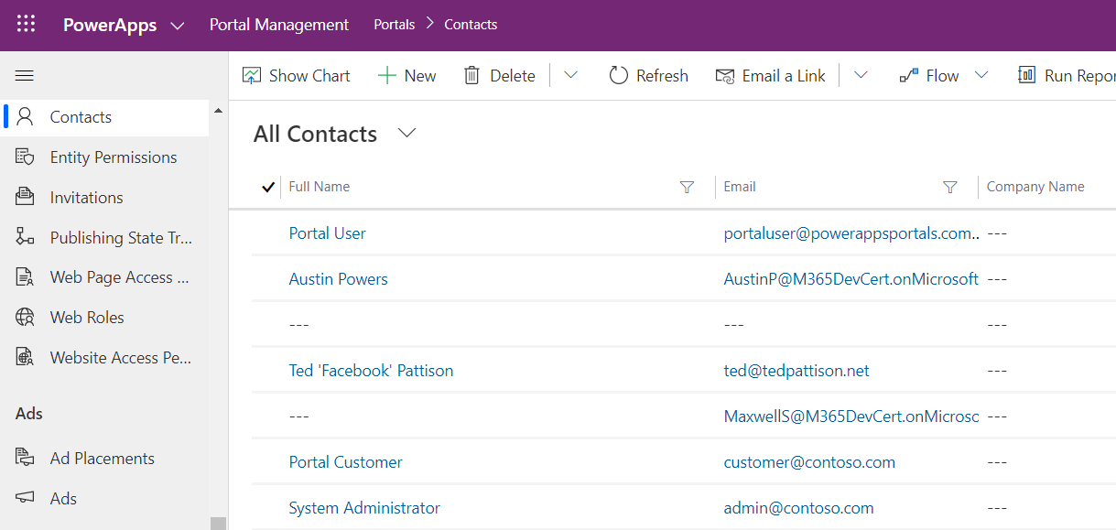
Examining Portal Contacts

Slide 41
Configuring Portal Authorization
Web Roles
Web Page Access Rules
Website Permissions
Entity Permissions

Slide 42
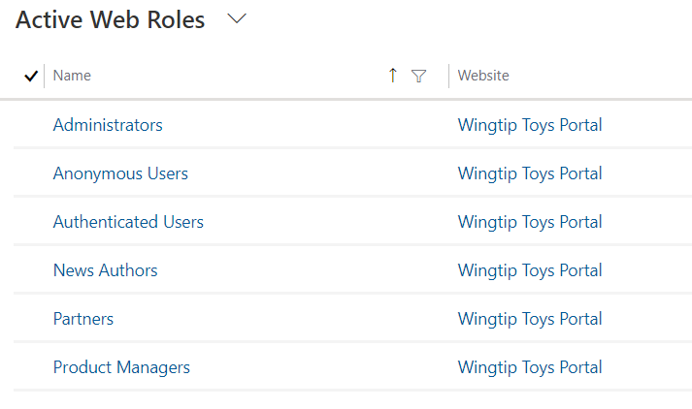
Web Roles
Web roles allow administrator to control access
Contact can be assigned to one or more web roles
Account can be assigned to one or more web roles
Invitation associated with parent account and set of web roles

Slide 43
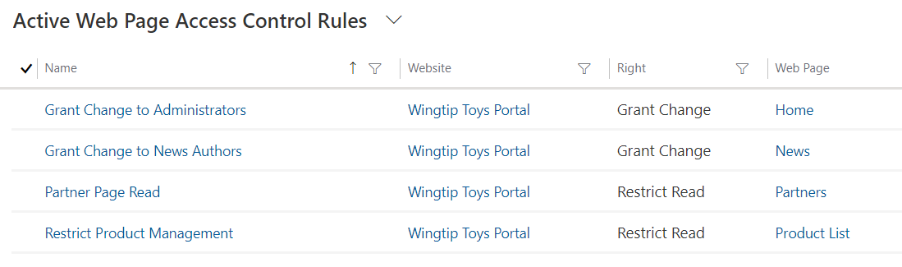
Web Page Access Rules
Web page access rule records used to manage access
Web page access rule used to restrict page viewing
Web page access rule used to provide editing/publishing permissions
Web page access rule associated with a single page
Child page access control through parent page access rule
Web page access control rule rights
Restrict read access
Allow content editing

Slide 44
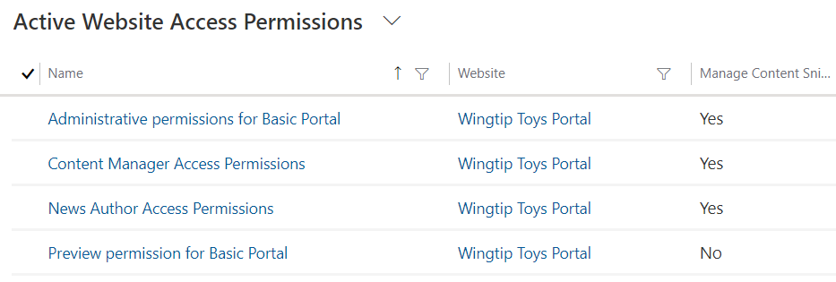
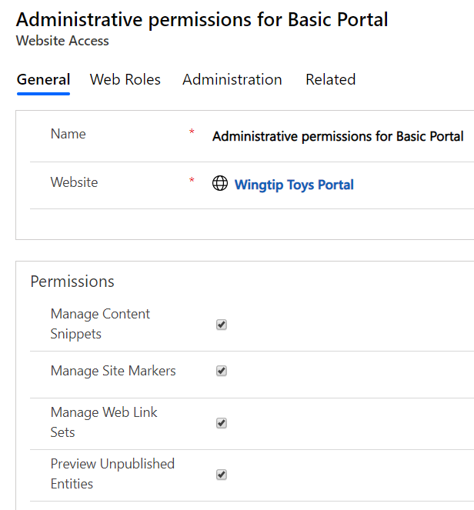
Website Access Permissions
Used to give permissions to content authors

Slide 45
Agenda
Creating a Power Apps Portal
Adding and Editing Portal Content
Writing Liquid Template Language Expressions
Understanding Portal Configuration
Configuring Portal Security
Publishing Dynamic CDS Content

Slide 46
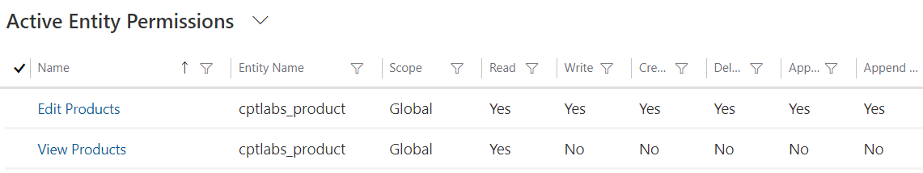
Entity Permissions
Entity permissions grants access to CDS records
Permissions can be read-only
Permissions can allow inserts, updates and deletes

Slide 47
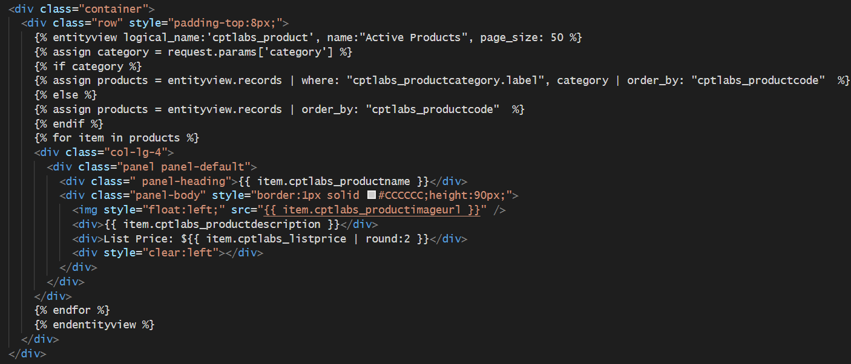
Accessing CDS Entity Data using Liquid
You can write liquid expressions to CDS surface data

Slide 48
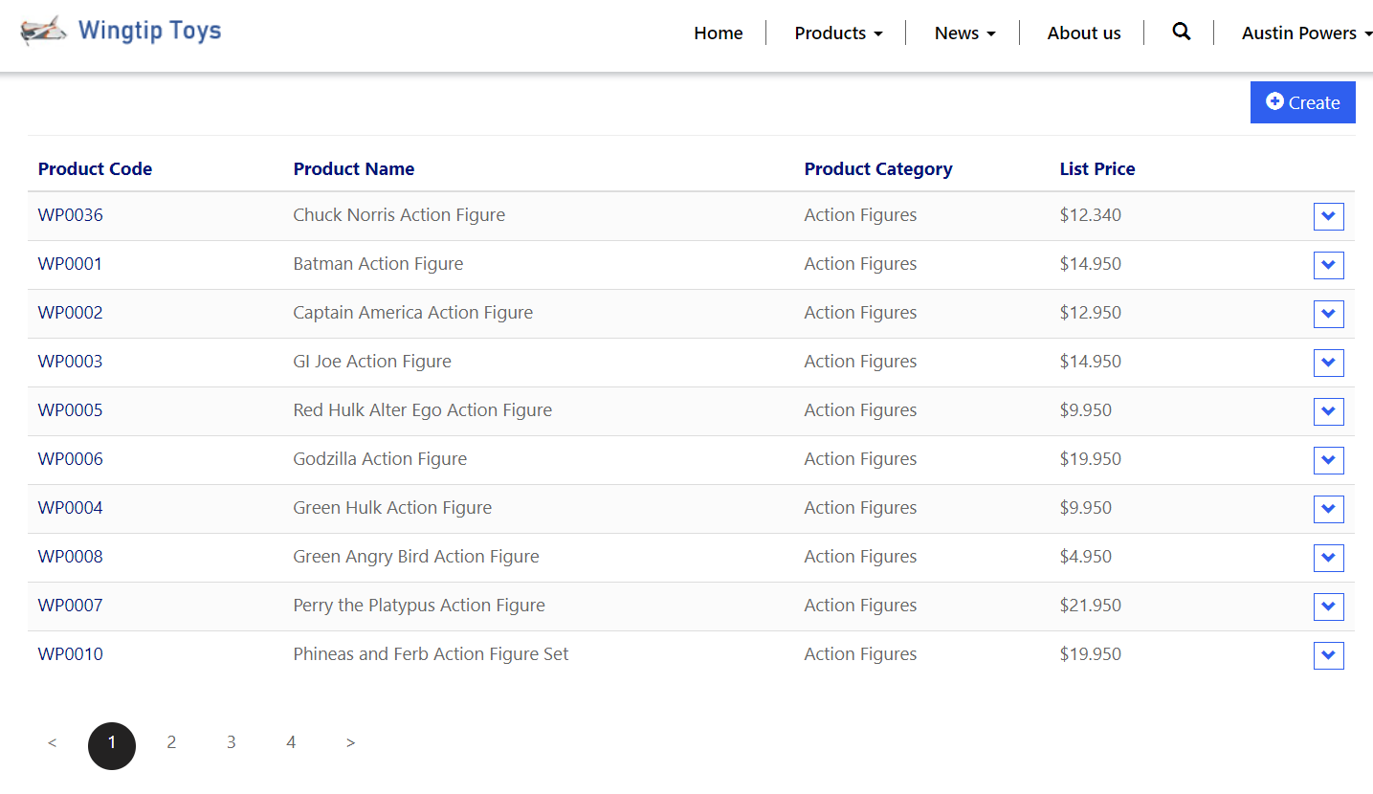
View CDS Data with Entity View
CDS Allows you to add entity views
Use views from a custom entity to surface data on portal page

Slide 49
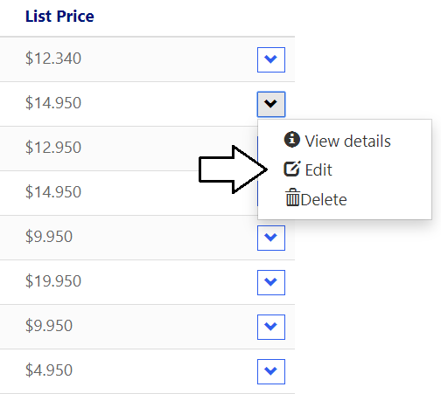
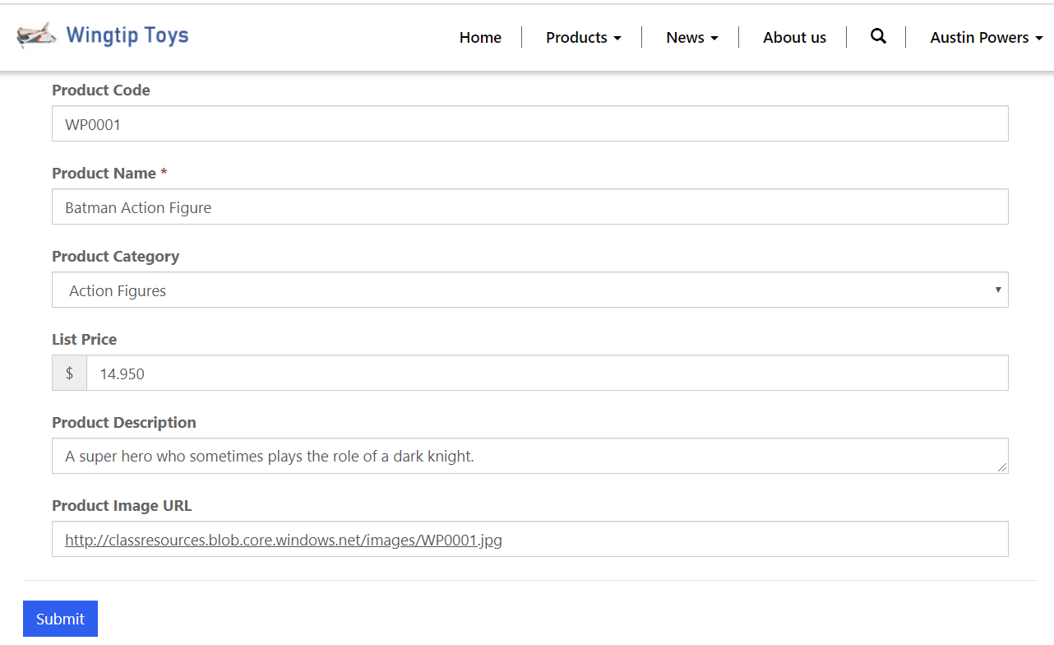
Updating CDS Data with Entity Forms
Entity forms can be used to allow user editing
Users can edit existing CDS records
Users can add new CDS records

Slide 50
Summary
Creating a Power Apps Portal
Adding and Editing Portal Content
Writing Liquid Template Language Expressions
Understanding Portal Configuration
Configuring Portal Security
Publishing Dynamic CDS Content

